Slide 1
THE PARKING GIANT
Problem statement :-
Insufficient space for car parking
Team leader:-Navadeep
Members:- Narshima
Spandana
Surya
Yamini

Slide 2
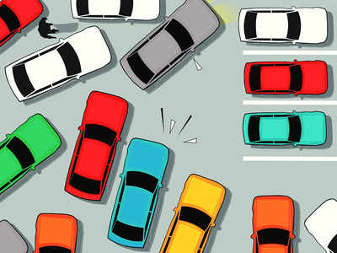
Problem
In the present world the usage of vehicles has become more and more common .Each and every house has at least 2 cars and 3 bikes individually for everyone in the house .So when these vehicles are coming out there is no space for parking all these vehicles .The parallel parking only limits to a fewer vehicles and it does not have much of organised parking ,So it becomes a problem for the vehicles to park Even after parking the vehicle there is a problem for removing it as there are a lot other vehicles parked along side it until those are moved the vehicles can’t be moved.

Slide 3
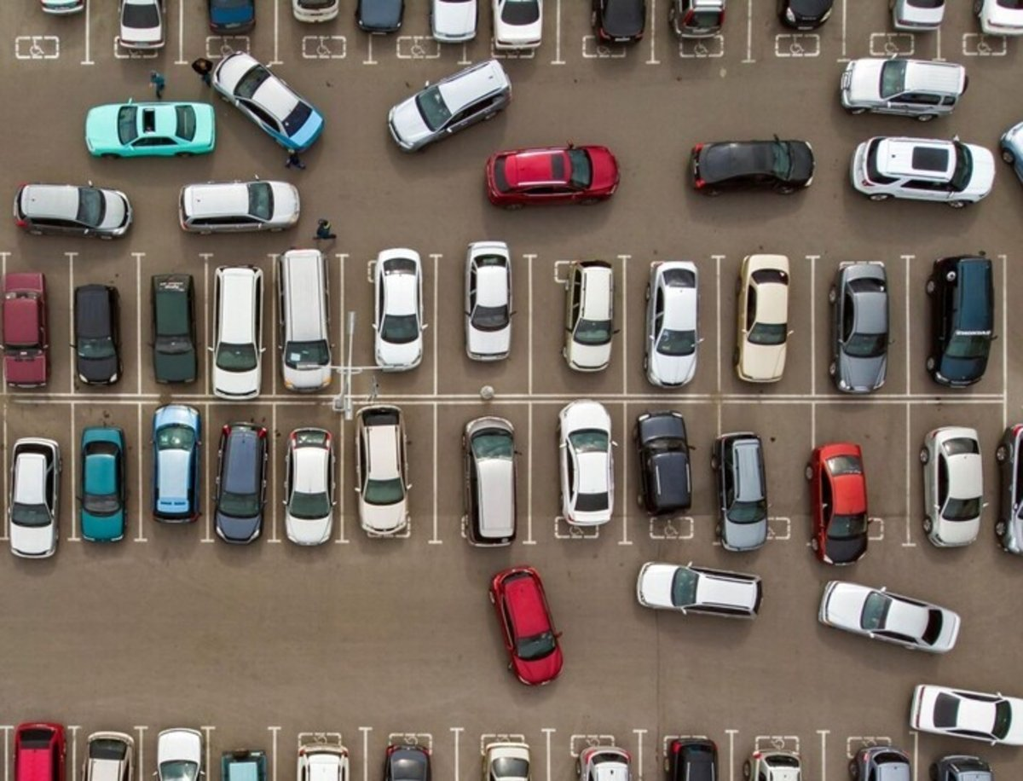
This problem basically arises due unorganized parking/improper parking .
The main reason for the parking problems are
Shortage of parking space,
high parking tariffs and
traffic congestion due to visitors in search for a
parking place
Parking in ‘no parking’ zone areas

Slide 4
IDEA TO SOLVE
So to solve this problems faced by parking we have come up with a solution
We can say that by this solution there will no issue in parking the vehicles as it is simple and easy and the above mentioned problems are solved
The solution name is the
THE PARKING GIANT

Slide 5
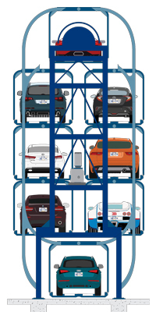
The Parking Giant
In this solution we came up with an idea where we can reduce the parking space and the parked vehicles can be removed easily without disturbing the other vehicles
It’s a kind of a giant rotating wheel which can park
Vehicles in it and uses this function to park vehicles
Many parking problems are solved by this parking method which are faced by today society

Slide 6
Advantages
By this parking method 6-8 cars can be parked instead of 1-2 cars.
The ground area required for this method is much less compared to vehicle’s parked at the ground.
This method doesn’t require vehicles to get blocked while moving away from the parking area.
It’s a simple and easy rotation process as it doesn’t require any manual work or labors.
The maintenance of this parking system is easy .

Slide 7
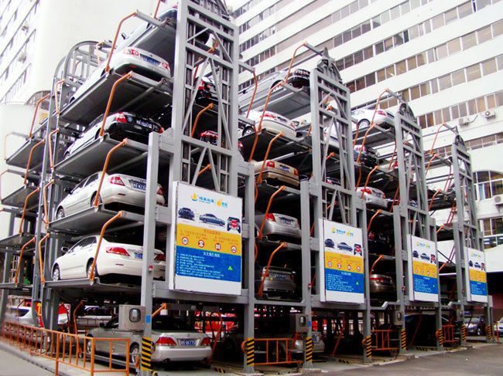
As this method doesn’t require so much of ground area so more number of vehicles can parked in that area .
As more vehicles are parked the traffic caused by this can be reduced to a great extent .
Now People don’t need to wait for free parking slots as there would be so much of place to park .

Slide 8
CONCLUSION
So ,in the end we want to conclude that this parking system named the PARKING GIANT is a effective way for parking vehicles that saves
A lot of parking space
It’s a time saving method for great use
No need to wait for clearing the place of parking, as
there would be enough space for parking.

Slide 9
THANK YOU

